Slide 1
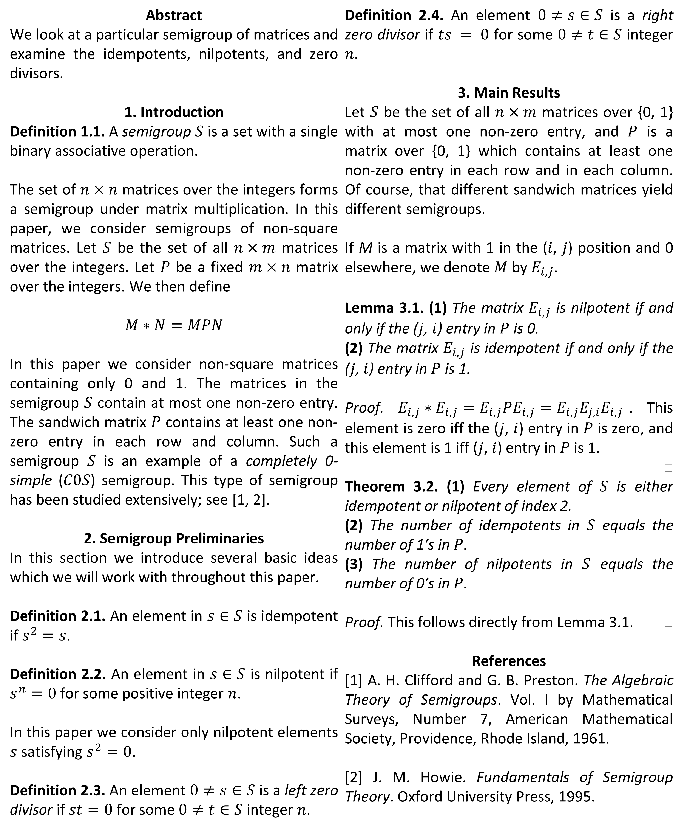
Completely Simple Zero Semigroups Omar Essa, Dr. Scott McDermott, Dr. Ralph P. Tucci
Abstract
We look at a particular semigroup of matrices and examine the idempotents, nilpotents, and zero divisors.
1. Introduction
Definition 1.1. A semigroup $S$ is a set with a single binary associative operation.
The set of $n×n$ matrices over the integers forms a semigroup under matrix multiplication. In this paper, we consider semigroups of non-square matrices. Let $S$ be the set of all $n×m$ matrices over the integers. Let $P$ be a fixed $m×n$ matrix over the integers. We then define
$M∗N=MPN$
In this paper we consider non-square matrices containing only 0 and 1. The matrices in the semigroup $S$ contain at most one non-zero entry. The sandwich matrix $P$ contains at least one non-zero entry in each row and column. Such a semigroup $S$ is an example of a completely 0-simple ($C0S$) semigroup. This type of semigroup has been studied extensively; see [1, 2].
2. Semigroup Preliminaries
In this section we introduce several basic ideas which we will work with throughout this paper.
Definition 2.1. An element in $s∈S$ is idempotent if $s^{2}=s$.
Definition 2.2. An element in $s∈S$ is nilpotent if $s^{n}=0$ for some positive integer $n$.
In this paper we consider only nilpotent elements $s$ satisfying $s^{2}=0$.
Definition 2.3. An element $0≠s∈S$ is a left zero divisor if $st=0$ for some $0≠t∈S$ integer $n$.
Definition 2.4. An element $0≠s∈S$ is a right zero divisor if $ts = 0$ for some $0≠t∈S$ integer $n$.
3. Main Results
Let $S$ be the set of all $n×m$ matrices over {0, 1} with at most one non-zero entry, and $P$ is a matrix over {0, 1} which contains at least one non-zero entry in each row and in each column. Of course, that different sandwich matrices yield different semigroups.
If M is a matrix with 1 in the ($i$, $j$) position and 0 elsewhere, we denote $M$ by $E_{i,j}$.
Lemma 3.1. (1) The matrix $E_{i,j}$ is nilpotent if and only if the ($j$, $i$) entry in $P$ is 0.
(2) The matrix $E_{i,j}$ is idempotent if and only if the ($j$, $i$) entry in $P$ is 1.
Proof. $E_{i,j}∗E_{i,j}=E_{i,j}PE_{i,j}=E_{i,j}E_{j,i}E_{i,j}$. This element is zero iff the ($j$, $i$) entry in $P$ is zero, and this element is 1 iff ($j$, $i$) entry in $P$ is 1.
□
Theorem 3.2. (1) Every element of $S$ is either idempotent or nilpotent of index 2.
(2) The number of idempotents in $S$ equals the number of 1′s in $P$.
(3) The number of nilpotents in $S$ equals the number of 0′s in $P$.
Proof. This follows directly from Lemma 3.1. □
References
[1] A. H. Clifford and G. B. Preston. The Algebraic Theory of Semigroups. Vol. I by Mathematical Surveys, Number 7, American Mathematical Society, Providence, Rhode Island, 1961.
[2] J. M. Howie. Fundamentals of Semigroup Theory. Oxford University Press, 1995.

